Slide 1
MPMC MINOR PROJECT
TILT SENSOR USING ARDUINO UNO
Presented by:-
181FA05114-P.Sai Krishna
181FA05118-P.Likhitha
181FA05035-K.Vignesh

Slide 2
Abstract
The main objective of this project is to detect the orientation of an object using Tilt sensor with Arduino.

Slide 3
CONTENTS
Introduction
Components required
Components Description
Circuit Diagram
Working
Advantages
Disadvantages
Applications
References

Slide 4
Introduction
A Tilt sensor switch is an electronic device that detects the orientation of an object and gives its output high or low accordingly. Basically, It has a mercury ball inside it which moves and makes the circuit. So Tilt sensor can turn ON or OFF the circuit based on the orientation.
A simple tilt sensor is basically a switch that will turn ON or OFF based angle or orientation of the sensor. Such sensor is useful for single axis tilt detection.

Slide 5
contd…
Tilt sensors are devices that produce an electrical signal that varies with an angular movement. These sensors are used to measure slope and tilt within a limited range of motion. Sometimes, the tilt sensors are referred to as inclinometers because the sensors just generate a signal but inclinometers generate both readout and a signal.
The components here we using are Tilt sensor, Arduino, Resistor, Bread board, Jumper wires.

Slide 6
Components Required
Arduino Uno
Tilt sensor
LED
Resistor – 220 ohms
Buzzer
Bread board
Connecting wires

Slide 7
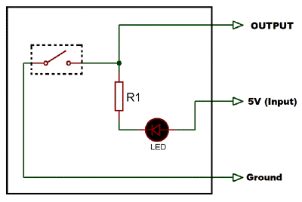
Components Description
Tilt Sensor:
A Tilt sensor is an instrument that is used for measuring the tilt in multiple axes of a reference plane. Tilt sensors measure the tilt position with reference to gravity and are used in numerous applications. They enable the easy detection of orientation or inclination .
Fig -1:Tilt sensor circuit

Slide 8
LED:
As it’s name implies it is diode , which emits light when forward biased. Charge carrier recombination takes place when electrons from the N-side cross the junction and recombine with the holes on the p-side.
Electrons are in the higher conduction band on the n-side where as holes are in the lower valance band on the p-side during recombination, some of the energy is given up in the form of heat and light.

Slide 9
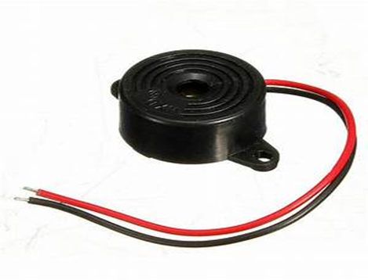
BUZZER:
A buzzer or beeper is an audio signaling device, which may be mechanical, piezoelectric, electromechanical uses of buzzers and beepers include devices, timers and confirmation of user input such as a mouse click or keystore.
Fig 2: Buzzer

Slide 10
ARDUINO UNO:
The 14 digital input/output pins can be used as input/output pins by using pinMode(),digitalRead() and digitalWrite() functions in Arduino programming. Out of these 14 pins,some pins have specific functions has listed below:
Serial Pins 0 (Rx) and 1(Tx): Rx and Tx pins are used to receive and transmit TTL serial data. They are connected with the corresponding ATmega328P USB to TTL serial chip.
External Interrupt pins 2 and 3: This pins can be configured to trigger and interrupt on a low value , a rising or falling edge, or a change in value

Slide 11
contd…
PWM Pins 3,5,6,9 and 11: These pins provide a 8 bit PWM output by using analogWrite() Function.
In-built LED pin 13: This pin is connected with an built-in LED, when pin 13 is HIGH-LED is on and when pin 13 is LOW-LED is off.
Arduino UNO has a couple of other pins as explained below:
AREF: Used to provide reference voltage for analog inputs with analogReference() function.
Reset Pin: Making this pin low, resets the microcontroller.

Slide 12
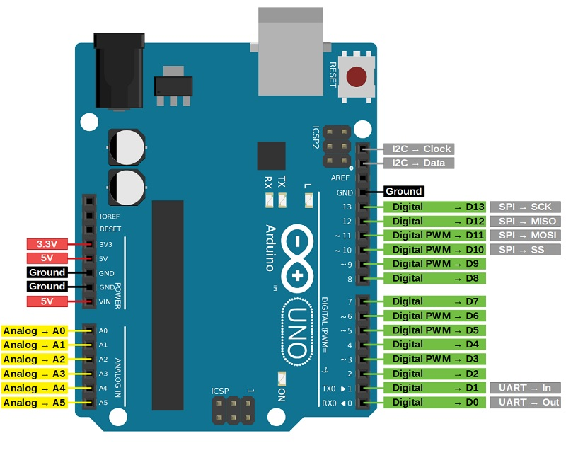
Contd..
Fig 3. Pin Diagram of Arduino Uno

Slide 13
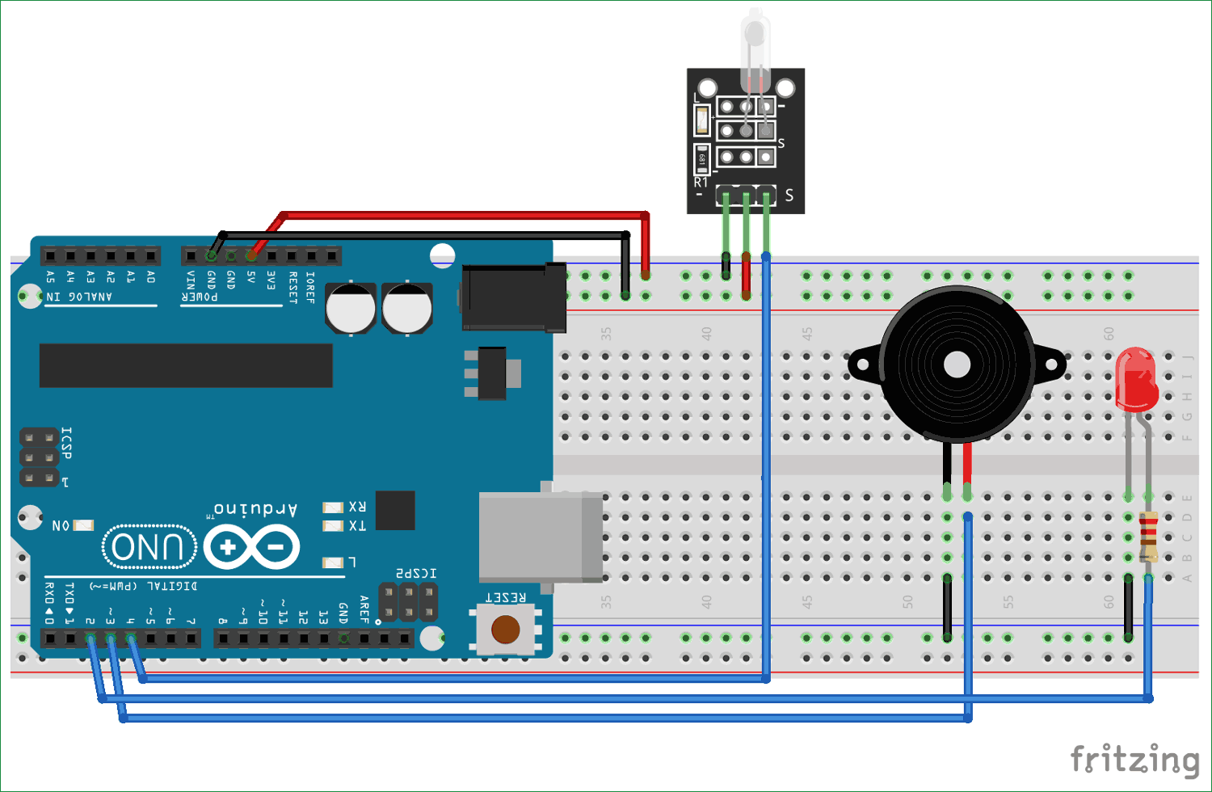
Circuit Diagram
Fig 4. Circuit Diagram of Tilt sensor using Arduino UNO

Slide 14
Working
To connect a tilt sensor with the Arduino, it requires 5v DC input to operate. That 5v is supplied using Arduino UNO and the output of tilt sensor is taken at pin4 of Arduino.
LED is connected with the pin2 of Arduino UNO with 220 ohm resistor to limit the current to a safe value and the buzzer is directly connected to the pin3 of Arduino UNO.
In this project, an Arduino will sense the tilt of the sensor and triggers a buzzer and an LED. The code for Arduino is written and uploaded to the Arduino board.
When the tilt of the sensor is detected, the buzzer and LED are triggered by Arduino.

Slide 15
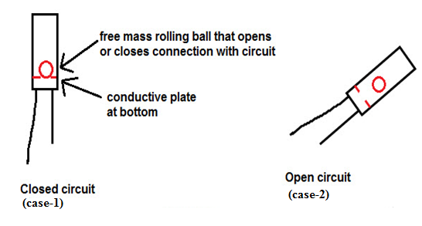
contd…

Slide 16
Advantages
Cost effective
Low power consumption
High resolution and accuracy
Very compact and simple to use.

Slide 17
Disadvantages
They require gravity for its operation(i.e, to roll a mercury ball).Hence these switches are not preferable under low gravity, reversed gravity or zero gravity conditions.
Tilt switches deliver inadequate results under significant vibrant conditions.
When this tilt switch is subjected to current above its rated specification, it will become less reliable.

Slide 18
Applications
To monitor the angle at which a mobile phone or tablet held to rotate the auto function.
To indicate the position of hand-held game systems and in game controller.
To indicate the roll of aircrafts, boats and vehicles.

Slide 19
References:
.https://circuitdigest.com/microcontroller-projects/arduino-tilt-sensor-interfacing
https://www.elprocus.com/tilt-sensor-types-working-principle-and-its-applications/

Slide 20

.

